Slide 1
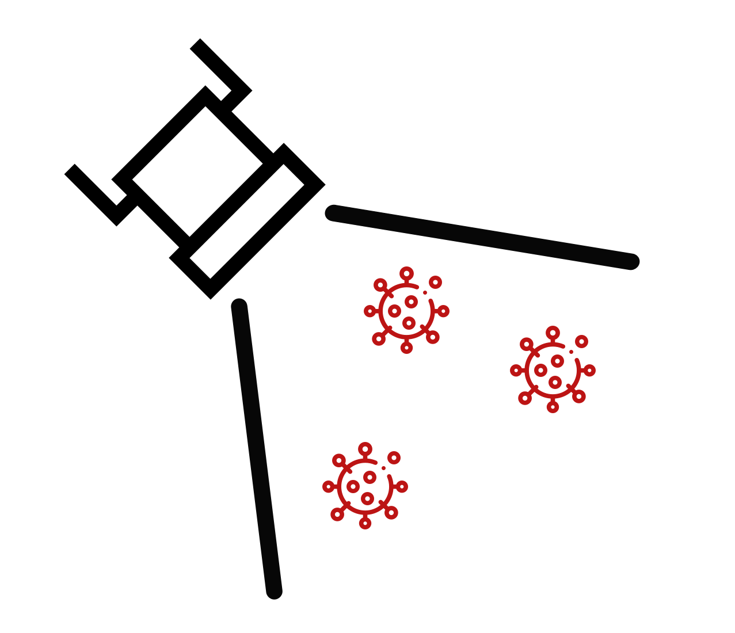
FloodLAMP
CLEAN
Wear lab coat and gloves
Keep surfaces clean

Slide 2
FloodLAMP
DIRTY

